Slide 3
M
M
M
M

Slide 4



0
M
$$\vec{y_{0}}$$
M
$$\vec{z_{0}}$$
$$\vec{x_{0}}$$
1
2
3

Slide 5



1
$$\vec{x_{0}}$$
2
0
$$\vec{y_{0}}$$
$$\vec{z_{0}}$$

Slide 6
$$\vec{x_{0}}$$
1
2
0
$$\vec{y_{0}}$$
$$\vec{z_{0}}$$

Slide 7






$$v(t)$$
$$v_{max}$$
$$t$$
$$t_{1}$$
$$t_{2}$$
$$t_{3}$$

Slide 8




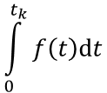

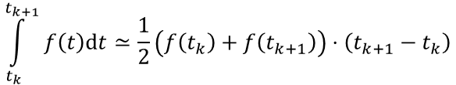
$$f(t)$$
$$f\left(t_{k}\right)$$
$$f\left(t_{k+1}\right)$$
$$\int_{0}^{t_{k}}{f\left(t\right)dt}$$
$$t$$
$$t_{k}$$
$$t_{k+1}$$
$$\int_{t_{k}}^{t_{k+1}}{f\left(t\right)dt}≃\frac{1}{2}\left(f\left(t_{k}\right)+f\left(t_{k+1}\right)\right)⋅\left(t_{k+1}−t_{k}\right)$$

Slide 9





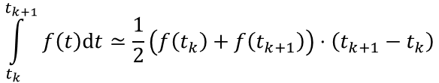
$$v(t)$$
$$v_{i}$$
$$v_{i+1}$$
$$x_{i}=\int_{0}^{t_{i}}{v\left(t\right)dt}$$
$$t$$
$$t_{i}$$
$$t_{i+1}$$
$$\int_{t_{k}}^{t_{k+1}}{f\left(t\right)dt}≃\frac{1}{2}\left(f\left(t_{k}\right)+f\left(t_{k+1}\right)\right)⋅\left(t_{k+1}−t_{k}\right)$$

